Slide 1
CPU高效编程技术
核心系统数据库组 褚霸(余锋)
http://blog.yufeng.info
2013-5-7

Slide 2
微处理器的核心技术
流水线处理
运算器高速化
RISC和CISC
超标量执行
乱序执行
分支预测
缓存
多核心

Slide 3
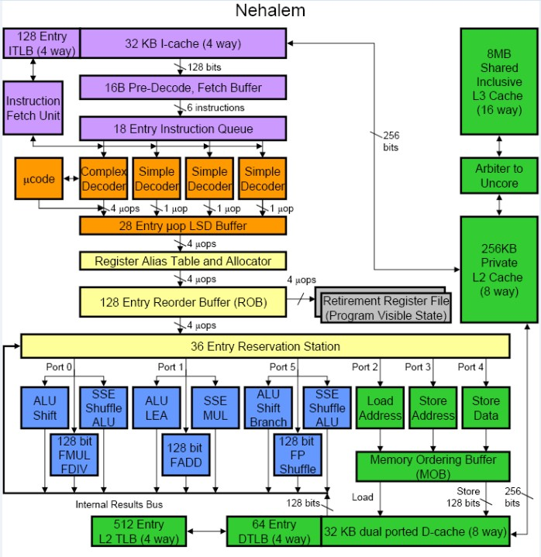
了解处理器Nehalem E5620
长流水线 >= 15级
X86指令解释为微指令后乱序执行
等待执行的微指令放在Reserveration Station
多个ALU运算单元并发、乱序执行
Reorder Buffer中实现串行化
Instruction Retirement

Slide 4
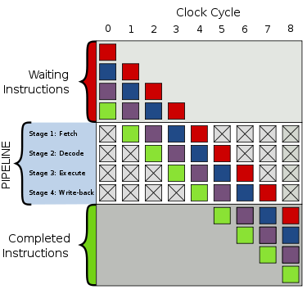
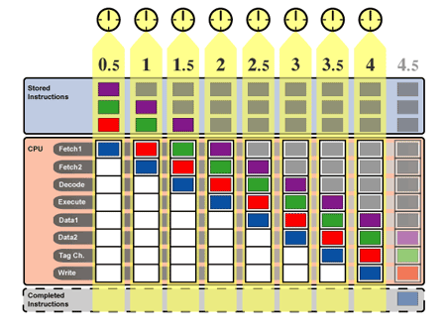
Pipeline
示例：4级和8级的流水线

Slide 5
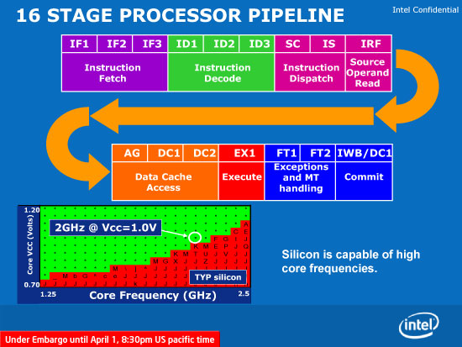
Intel的长流水线

Slide 6
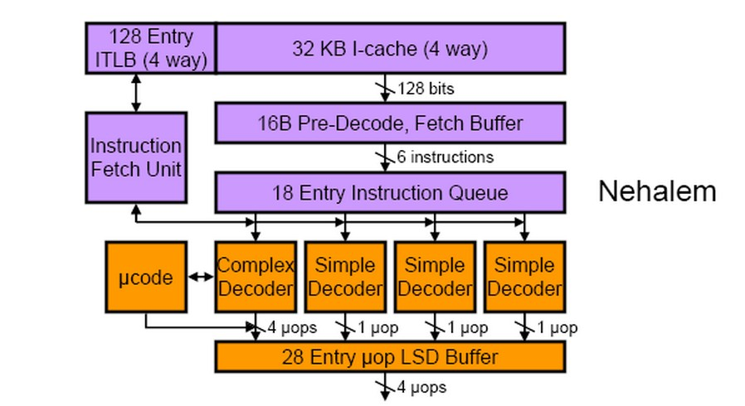
Front End
读入x86指令，
每个时钟周期
16字节
x86指令解析为微指令（μop）
微指令（μop）缓存

Slide 7
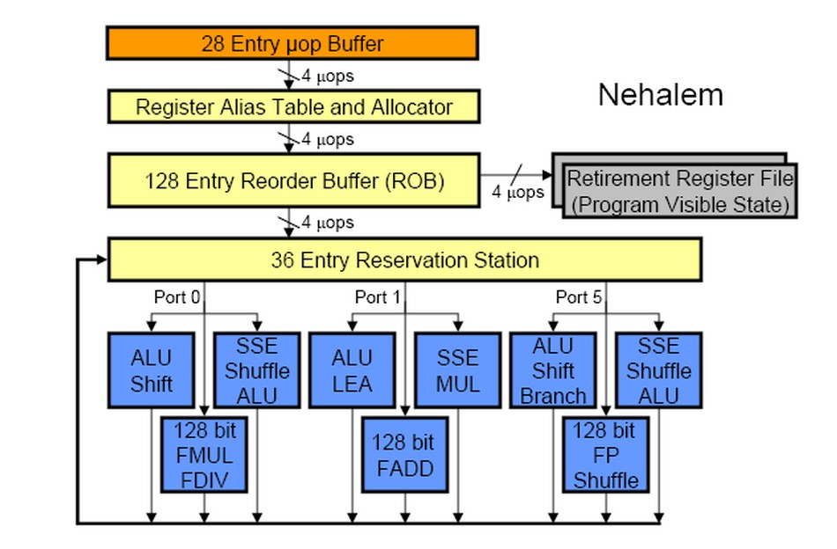
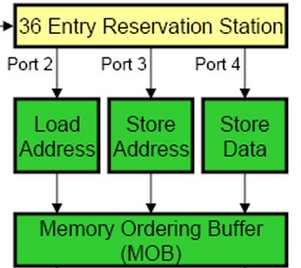
乱序执行-1
寄存器重命名
分配临时寄存器
微指令进入保留站
发射指令
EU
EU
EU
各种运算
Load/Store

Slide 8
乱序执行-2
按指令顺序写出结果
指令生效，真正写入
内存和物理寄存器
存入临时寄存器
触发具有数据依赖的指令执行
EU中计算结果
Load/Store

Slide 9
指令量化分析
取指令，每个16字节/cycle
X86指令解析为微指令
简单指令3条/cycle
复杂指令1条/cycle
保留站到EU的Port，总共6个
P0，P1，P5到ALU单元
P2，P3，P4到Load/Store单元
Instruction Retirement，4条μop/cycle
Dependency Chain长度

Slide 10
指令优化
长流水线 >= 15级
Branch prediction miss性能损耗大
减少Branch prediction miss率
减少/消除conditional branch
Bit运算代替比较
Comvg指令代替比较
充分发挥Intel处理器乱序执行的能力
避免指令间存在long dependency chain
避免指令间隐性的依赖关系，例如对eflags的依赖

Slide 11
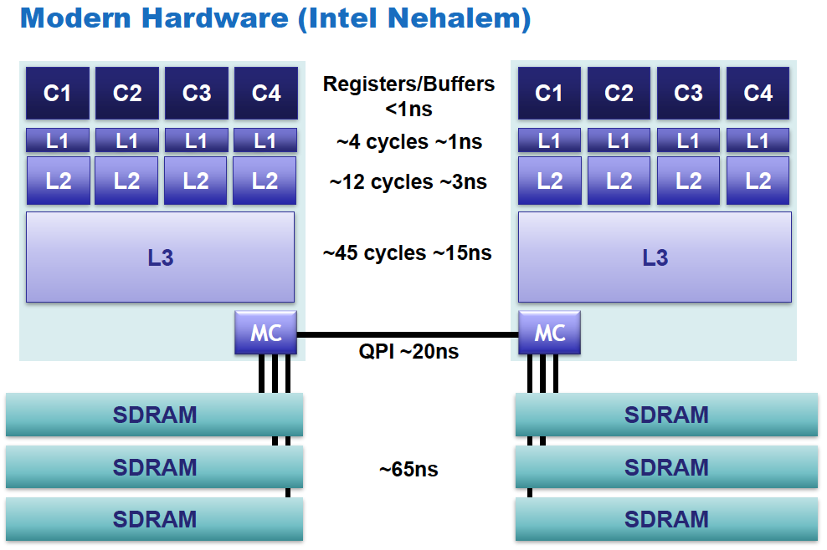
CPU内部各部件访问速度

Slide 12
充分利用寄存器
# define LZ4_COPYSTEP(s,d) A64(d) = A64(s); d+=8; s+=8;
# define LZ4_COPYPACKET(s,d) LZ4_COPYSTEP(s,d)
#define LZ4_WILDCOPY(s,d,e) do { LZ4_COPYPACKET(s,d) } while (d<e);

Slide 13
位运算
int r;
if (!(val>>32)) { r=4; } else { r=0; val>>=32; }
if (!(val>>16)) { r+=2; val>>=8; } else { val>>=24; }
r += (!val);
return r;

Slide 14
并行执行
*op++ = *ref++;
*op++ = *ref++;
*op++ = *ref++;
*op++ = *ref++;

Slide 15
消除Conditional Branch
如何消除这个if语句
if (a < b) {
r = c;
} else {
r = d;
}
Bit运算版本1
int mask = (a-b) >> 31;
r = (mask & c) | (~mask & d);
Bit运算版本2
int mask = (a-b) >> 31;
r = d + mask & (c-d);
cmovg版本
r = (a < b) ？c : d;

Slide 16
分支可能性提示
#define likely(expr) expect((expr) != 0, 1)
#define unlikely(expr) expect((expr) != 0, 0)
while likely(ip<matchlimit-(STEPSIZE-1))
{
…
}

Slide 17
The Blocking Technique

Slide 18
The Blocking Technique
// Increasing memory usage improves compression ratio
// Reduced memory usage can improve speed, due to cache effect
// Default value is 14, for 16KB, which nicely fits into Intel x86 L1 cache
#define MEMORY_USAGE 14
#define HASH_LOG (MEMORY_USAGE-2)
#define HASHTABLESIZE (1 << HASH_LOG)
struct refTables
{
HTYPE hashTable[HASHTABLESIZE];
};

Slide 19
memchr
magic_bits = ((unsigned long int) 0x7efefefe << 32) | 0xfefefeff;
/* Set up a longword, each of whose bytes is C. */
charmask = c | (c << 8); charmask |= charmask << 16; charmask |= charmask << 32;
/* Instead of the traditional loop which tests each character,
we will test a longword at a time. The tricky part is testing
if *any of the four* bytes in the longword in question are zero. */
while (n >= sizeof (longword))
{
longword = *longword_ptr++ ^ charmask;
if ((((longword + magic_bits)
& ~magic_bits) != 0)
{
…
}
}

Slide 20
memchr续
{
const unsigned char *cp = (const unsigned char *) (longword_ptr - 1);
if (cp[0] == c)
return (__ptr_t) cp;
...
if (cp[7] == c)
return (__ptr_t) &cp[7];
}
n -= sizeof (longword);
}

Slide 21
False sharing

Slide 22
对齐cacheline
typedef union {
GFAllctr_t gfa;
char align_gfa[ERTS_ALC_CACHE_LINE_ALIGN_SIZE(sizeof(GFAllctr_t))];
} ErtsAllocatorState_t;
char *states = erts_sys_alloc(0, … + ERTS_CACHE_LINE_SIZE - 1));
states = ((((UWord) states) & ERTS_CACHE_LINE_MASK)
? (char *) ((((UWord) states) & ~ERTS_CACHE_LINE_MASK)
+ ERTS_CACHE_LINE_SIZE)
: (char *) states);

Slide 23
perf list
RAW HARDWARE EVENT DESCRIPTOR
Even when an event is not available in a symbolic form within perf right now, it can be encoded in a
per processor specific way.
For instance For x86 CPUs NNN represents the raw register encoding with the layout of IA32_PERFEVTSELx
MSRs (see [Intel(R) 64 and IA-32 Architectures Software Developer's Manual Volume 3B: System Programming
Guide] Figure 30-1 Layout of IA32_PERFEVTSELx MSRs) or AMD's PerfEvtSeln (see [AMD64 Architecture
Programmer's Manual Volume 2: System Programming], Page 344, Figure 13-7 Performance Event-Select
Register (PerfEvtSeln)).

Slide 24
致谢
部分图片和代码来自鸣嵩 《treelink比赛分享》

Slide 25
多谢大家!
Questions？
QQ:526275
新浪微博:@淘宝褚霸
Gtalk: mryufeng@gmail.com

